Slide 1


<Name> Ng Xiang En
<Date> 9/1/2025

Slide 2

Outline
Executive Summary
Introduction
Methodology
Results
Conclusion
Appendix

Slide 3
Executive Summary
Summary of methodologies
Data collection
Data wrangling
Exploratory Data Analysis with Data Visualization
Exploratory Data Analysis with SQL
Building an interactive map with Folium
Building a Dashboard with Plotly Dash
Predictive analysis (Classiication)
Summary of all results
Exploratory Data Analysis results
Interactive analytics demo in screenshots
Predictive analysis results

Slide 4
Introduction
Project background and context
SpaceX has established itself as the most successful company of the commercial space age, revolutionizing space travel by making it more affordable. The company advertises Falcon 9 rocket launches at a cost of $62 million, significantly lower than the $165 million charged by other providers.
This cost efficiency is largely due to SpaceX's ability to reuse the first stage of its rockets. By leveraging public data and machine learning models, we aim to predict whether SpaceX will be able to reuse the first stage for a given launch.
Problems you want to find answers
How do factors like payload mass, launch site, number of flights, and orbit type influence the success of the first-stage landing?
Has the success rate of landings improved over the years?
Which algorithm is the most effective for binary classification in this scenario?

Slide 5

Section 1

Slide 6
Methodology
Executive Summary
Data collection methodology:
Using SpaceX Rest API
Using Web Scrapping from Wikipedia
Perform data wrangling
Filtering the data
Dealing with missing values
Using One Hot Encoding to prepare the data to a binary classiication
Perform exploratory data analysis (EDA) using visualization and SQL
Perform interactive visual analytics using Folium and Plotly Dash
Perform predictive analysis using classification models
Building, tuning and evaluation of classiication models to ensure the best results

Slide 7
Data Collection
The data collection process combined API requests from the SpaceX REST API with web scraping of data from a table in SpaceX's Wikipedia entry. Both methods were utilized to gather comprehensive information about the launches, ensuring a more detailed and thorough analysis.
Data Columns are obtained by using SpaceX REST API:
FlightNumber, Date, BoosterVersion, PayloadMass, Orbit, LaunchSite, Outcome, Flights, GridFins, Reused, Legs, LandingPad, Block, ReusedCount, Serial, Longitude, Latitude
Data Columns are obtained by using Wikipedia Web Scraping:
Flight No., Launch site, Payload, PayloadMass, Orbit, Customer, Launch, outcome, Version Booster, Booster landing, Date, Time

Slide 8
Data Collection – SpaceX API
Requesting Rocket Launch Data: Fetch launch data from the SpaceX API
Processing API Response: Decode the API response using .json() and convert it into a DataFrame with json_normalize()
Extracting Launch Details: Retrieve specific details about launches using custom functions applied to the SpaceX API data
Organizing Data: Compile the extracted launch information into a structured dictionary
Exporting Data: Save the processed DataFrame as a CSV file for further analysis
Handling Missing Data: Replace missing values in the Payload Mass column with the column's mean value
Filtering Falcon 9 Data: Filter the DataFrame to retain only records related to Falcon 9 launches
Creating a DataFrame: Convert the structured dictionary into a Pandas DataFrame for further processing
Link to Github: Data collection API

Slide 9
Data Collection – Web Scraping
Request Falcon 9 Launch Data: Retrieve launch data from Wikipedia
Create BeautifulSoup Object: Parse the HTML response using BeautifulSoup
Extract Column Names: Retrieve column headers from the HTML table
Parse HTML Tables: Extract data by processing the HTML table content
Export Data: Save the processed DataFrame to a CSV file
Convert to DataFrame: Create a Pandas DataFrame from the dictionary
Construct Dictionary: Organize the parsed data into a structured dictionary
Link to Github: Web Scraping

Slide 10
Data Wrangling
1. Conduct Exploratory Data Analysis (EDA)
In the dataset, various scenarios are recorded where the booster did not land successfully. In some cases, landings were attempted but failed due to accidents. For instance, "True Ocean" indicates that the booster successfully landed in a specific region of the ocean, while "False Ocean" means the landing was unsuccessful in the same context.
Similarly, "True RTLS" refers to a successful landing on a ground pad, whereas "False RTLS" indicates an unsuccessful attempt. For drone ship landings, "True ASDS" signifies a successful landing on a drone ship, while "False ASDS" represents an unsuccessful attempt. These outcomes are converted into training labels for analysis, where a "1" denotes a successful landing and a "0" indicates a failure.
2. Determine Launch Counts by Site
3. Analyse Orbit Types
4. Assess Mission Outcomes by Orbit
5. Generate Landing Outcome Labels
6. Export Processed Data
Link to Github: Data Wrangling

Slide 11
EDA with Data Visualization
Charts were plotted:
Flight Number vs. Payload Mass, Flight Number vs. Launch Site, Payload Mass vs. Launch Site, Orbit Type vs. Success Rate, Flight Number vs. Orbit Type, Payload Mass vs Orbit Type and Success Rate Yearly Trend
Scatter plots: These visualizations display the relationship between variables. If a pattern or relationship is observed, scatter plots can be valuable for machine learning model development.
Bar Charts: These charts compare values across distinct categories, highlighting the relationship between specific categories and their associated measured values.
Line Charts: These are used to illustrate trends and changes in data over time, making them ideal for analyzing time series data.
Link to Github: EDA with Data Visualisation

Slide 12
EDA with SQL
Performed SQL queries:
Displaying the names of the unique launch sites in the space mission
Displaying 5 records where launch sites begin with the string ‘CCA’
Displaying the total payload mass carried by boosters launched by NASA (CRS)
Displaying average payload mass carried by booster version F9 v1.1
Listing the date when the irst successful landing outcome in ground pad was achieved
Listing the names of the boosters which have success in drone ship and have payload mass greater than 4000 but less than 6000
Listing the total number of successful and failure mission outcomes
Listing the names of the booster versions which have carried the maximum payload mass
Listing the failed landing outcomes in drone ship, their booster versions and launch site names for the months in year 2015
Ranking the count of landing outcomes (such as Failure (drone ship) or Success (ground pad)) between the date 2010-06-04 and 2017-03-20 in descending order
Link to Github: EDA with SQL

Slide 13
Build an Interactive Map with Folium
Markers of all Launch Sites
Placed a marker with a circle, popup label, and text label at the coordinates of the NASA Johnson Space Center as the starting location.
Added markers with circles, popup labels, and text labels for all launch sites, using their latitude and longitude coordinates to highlight their geographical locations and proximity to the equator and coastlines.
Coloured Markers of the launch outcomes for each Launch Site:
Added color-coded markers for launches, with green representing successes and red representing failures, organized using a Marker Cluster to highlight which launch sites have relatively higher success rates.
Distances between a Launch Site to its proximities:
Added color-coded lines to represent the distances between the CCAFS SLC-40 launch site and nearby locations, including the railway, highway, coastline, and the nearest city.
Link to Github: Interactive Map with Folium

Slide 14
Build a Dashboard with Plotly Dash
Launch Sites Dropdown Menu:
Implemented a dropdown menu to allow selection of specific launch sites.
Pie Chart Displaying Launch Success (All Sites/Specific Site):
Added a pie chart to visualize the total number of successful launches across all sites, or the breakdown of success vs. failure for a selected launch site.
Payload Mass Range Slider:
Included a slider to adjust and filter the payload mass range for analysis.
Scatter Plot of Payload Mass vs. Success Rate for Booster Versions:
Created a scatter plot to analyze the relationship between payload mass and launch success, categorized by different booster versions.
Link to Github: Plotly Dash

Slide 15
Predictive Analysis (Classification)
Prepare the Target Variable: Create a NumPy array from the "Class" column in the dataset
Standardize the Data: Use StandardScaler to normalize the data by fitting and transforming it
Split the Dataset: Divide the data into training and testing sets using the train_test_split function
Set Up Hyperparameter Tuning: Create a GridSearchCV object with cv=10 to identify the best hyperparameters
Identify the Best Model: Determine the best-performing model by comparing Jaccard Score and F1 Score metrics
Examine Confusion Matrix: Analyze the confusion matrix for each model to assess classification performance
Evaluate Model Accuracy: Calculate the accuracy of all models on the test data using the .score() method
Apply GridSearchCV to Models: Perform hyperparameter tuning for Logistic Regression, SVM, Decision Tree, and KNN models
Link to Github: Predictive Analysis

Slide 16
Results
Exploratory data analysis results
Interactive analytics demo in screenshots
Predictive analysis results

Slide 17

Section 2

Slide 18
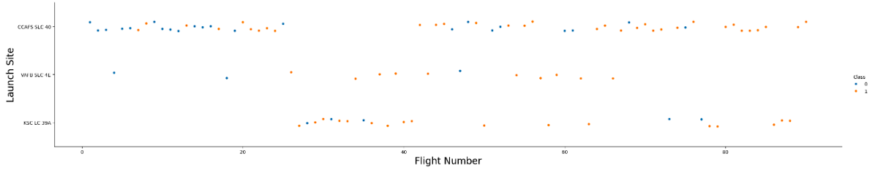
Flight Number vs. Launch Site
Explanation:
The earliest flights experienced failures, while the most recent flights have all been successful.
The CCAFS SLC-40 launch site accounts for approximately half of all launches.
The VAFB SLC-4E and KSC LC-39A launch sites demonstrate higher success rates.
It can be inferred that newer launches tend to have a higher success rate over time.

Slide 19
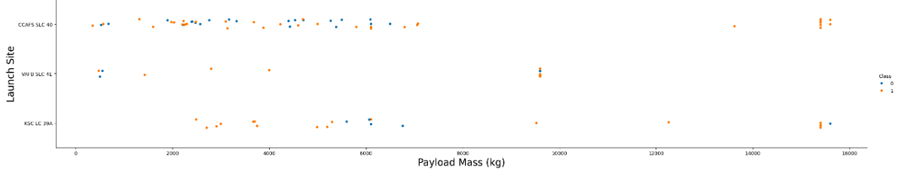
Payload vs. Launch Site
Explanation:
For all launch sites, success rates tend to increase with higher payload mass.
The majority of launches with a payload mass exceeding 7000 kg were successful.
The KSC LC-39A launch site boasts a 100% success rate for payloads weighing less than 5500 kg.

Slide 20
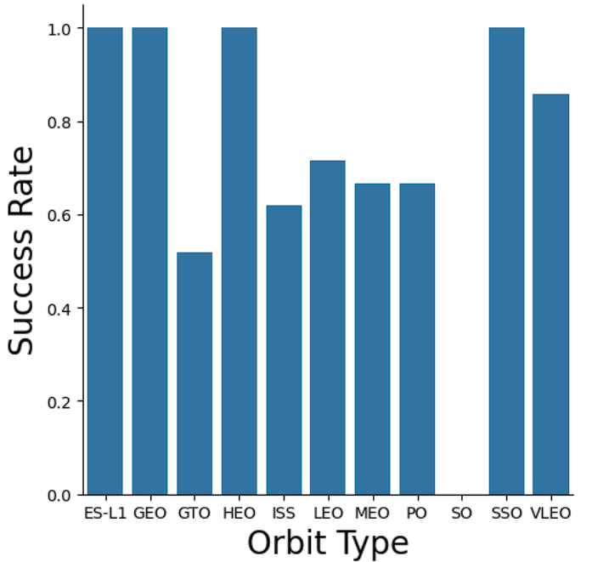
Success Rate vs. Orbit Type
Explanation:
Orbits with 100% success rate:
ES-L1, GEO, HEO, SSO
Orbits with 0% success rate:
SO
Orbits with success rate between 50% and 85%:
GTO, ISS, LEO, MEO, PO

Slide 21
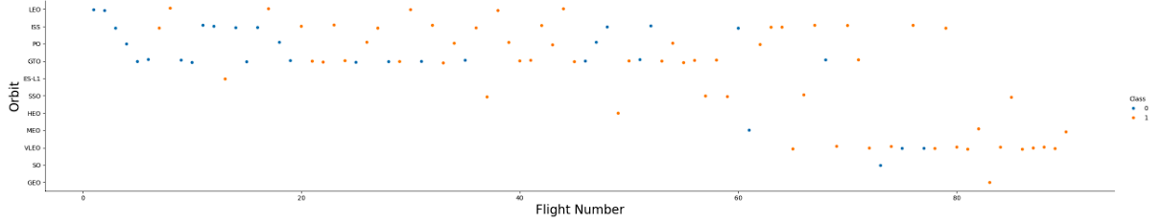
Flight Number vs. Orbit Type
Explanation:
In the LEO orbit, the success rate seems to be influenced by the number of flights.
Conversely, in the GTO orbit, there appears to be no correlation between the success rate and the number of flights.

Slide 22
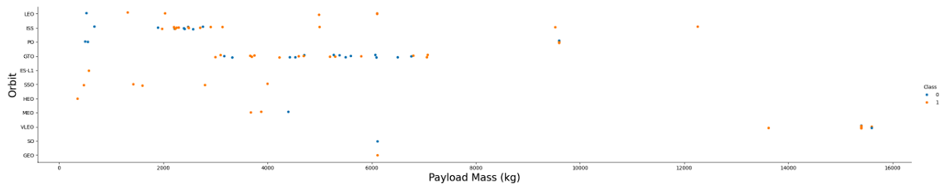
Payload vs. Orbit Type
Explanation:
Heavy payloads negatively impact success rates in GTO orbits but have a positive influence on Polar and LEO (ISS) orbits.

Slide 23
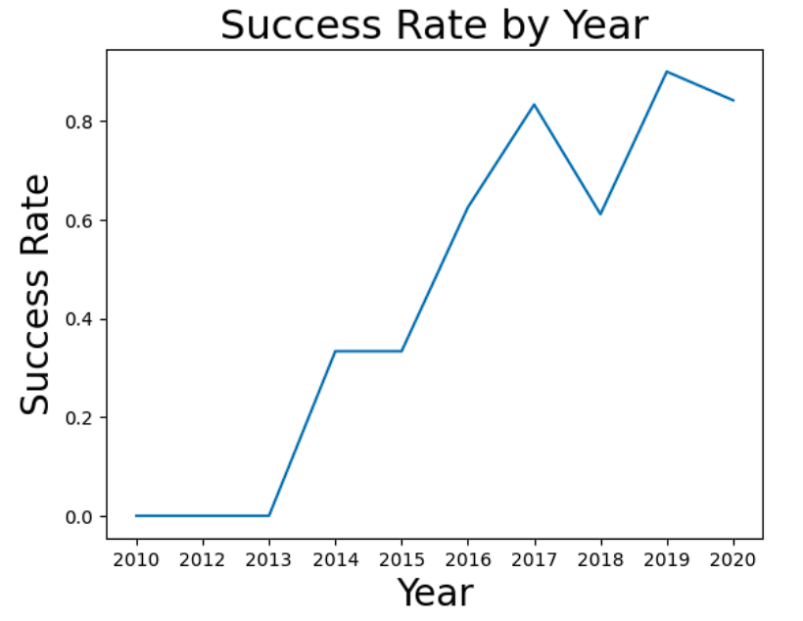
Launch Success Yearly Trend
Explanation:
The success rate steadily increased from 2013 to 2020.

Slide 24
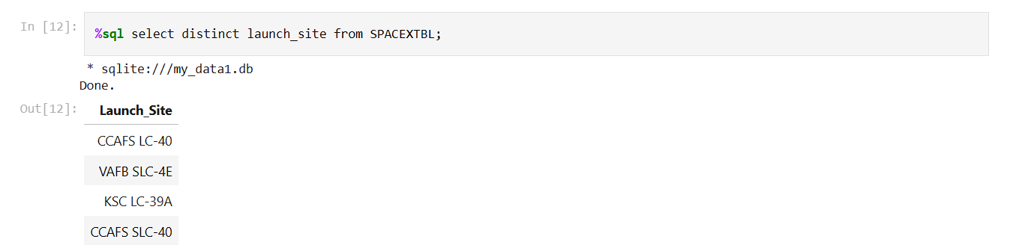
All Launch Site Names
Explanation:
Displaying the names of the unique launch sites in the space mission.

Slide 25
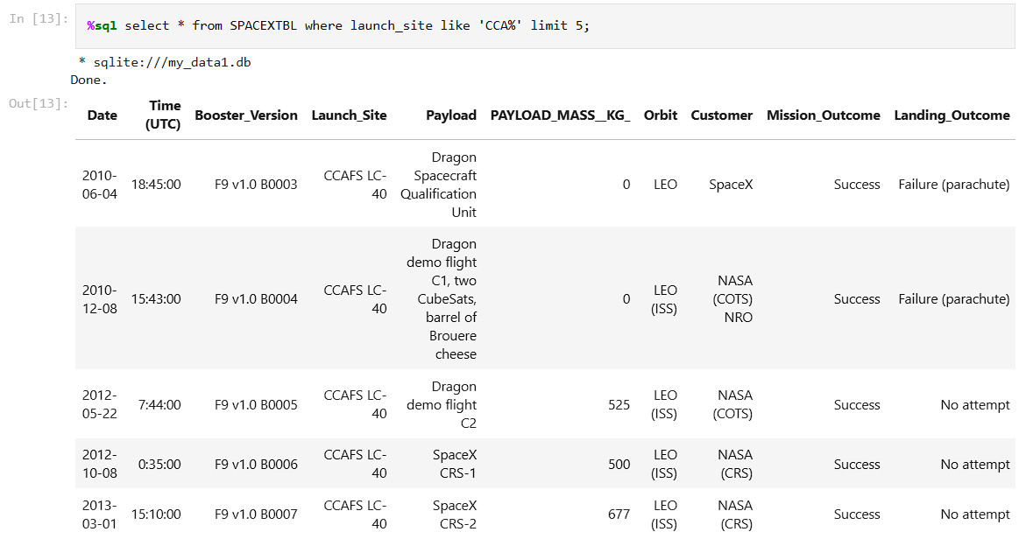
Launch Site Names Begin with 'CCA'
Explanation:
Listing the unique launch site names associated with the space missions

Slide 26
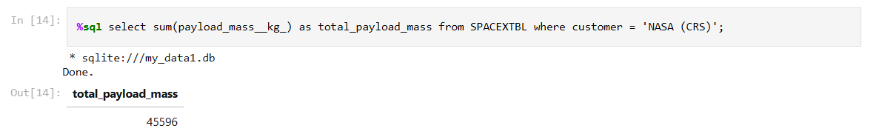
Total Payload Mass
Explanation:
Displaying the total payload mass carried by boosters launched by NASA (CRS)

Slide 27
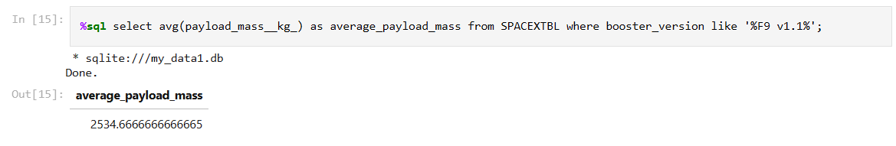
Average Payload Mass by F9 v1.1
Explanation:
Displaying average payload mass carried by booster version F9 v1.1

Slide 28
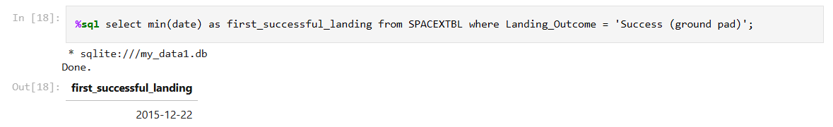
First Successful Ground Landing Date
Explanation:
Listing the date when the first successful landing outcome in ground pad was achieved

Slide 29
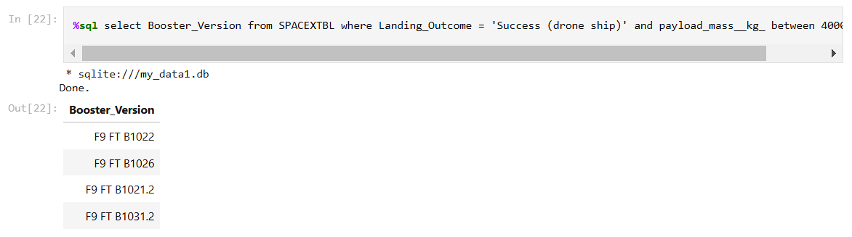
Successful Drone Ship Landing with Payload between 4000 and 6000
Explanation:
Listing the names of the boosters which have success in drone ship and have payload mass greater than 4000 but less than 6000

Slide 30
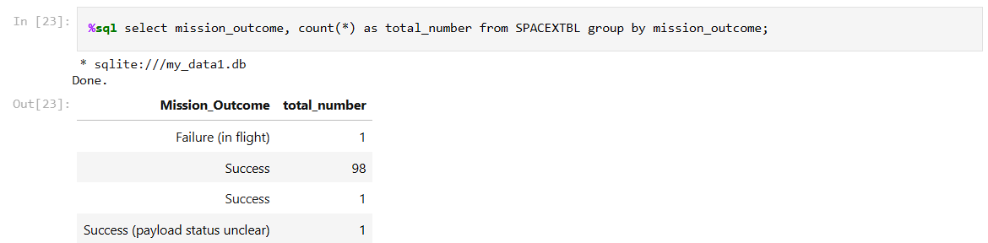
Total Number of Successful and Failure Mission Outcomes
Explanation:
Listing the total number of successful and failure mission outcomes

Slide 31
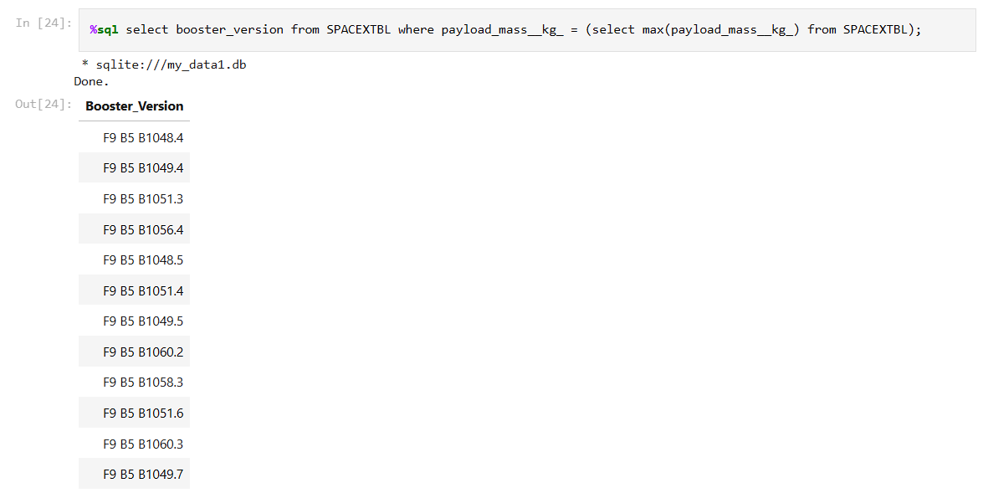
Boosters Carried Maximum Payload
Explanation:
Listing the names of the booster versions which have carried the maximum payload mass

Slide 32
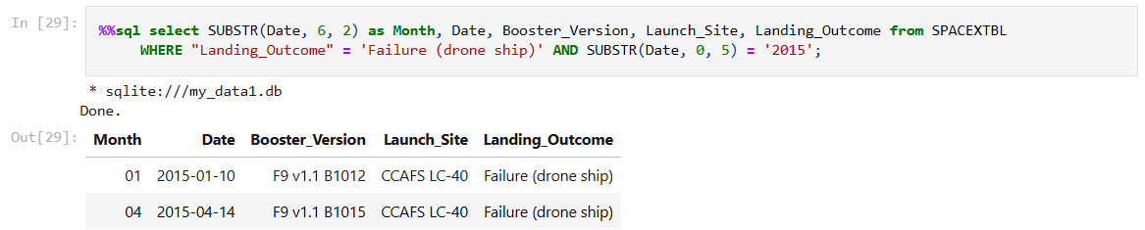
2015 Launch Records
Explanation:
Listing the failed landing outcomes in drone ship, their booster versions and launch site names for the months in year 2015

Slide 33
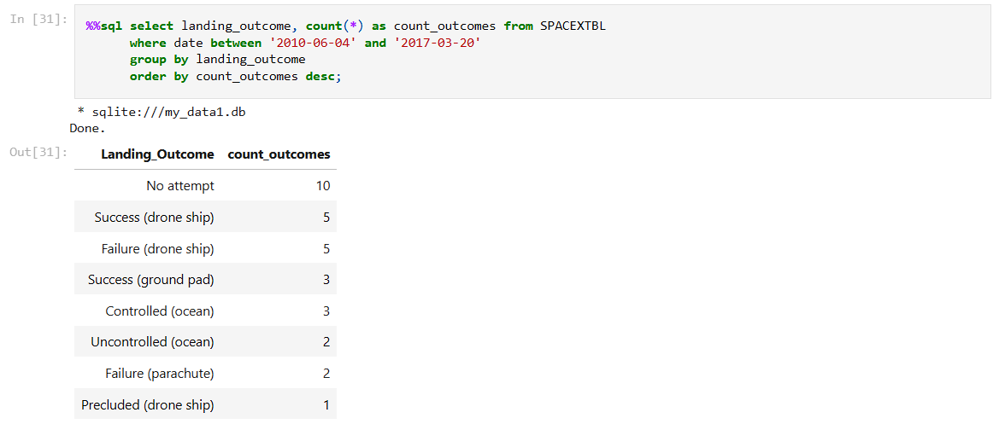
Rank Landing Outcomes Between 2010-06-04 and 2017-03-20
Explanation:
Ranking the frequency of landing outcomes (e.g., "Failure (drone ship)" or "Success (ground pad)") between the dates 2010-06-04 and 2017-03-20 in descending order

Slide 34

Section 3

Slide 35
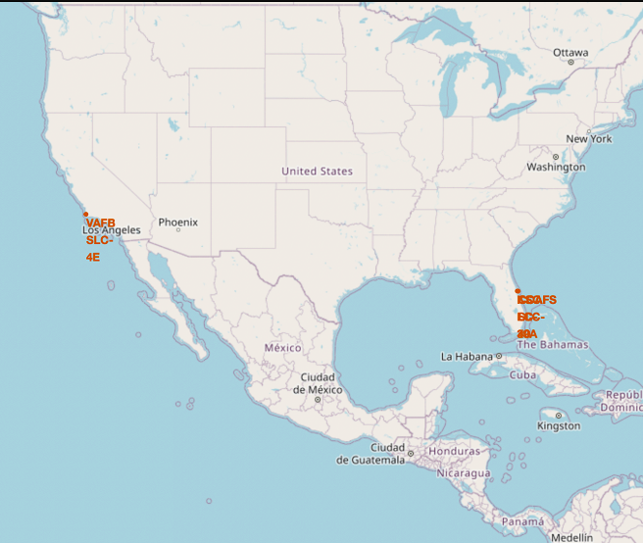
Markers indicating the locations of all launch sites displayed on a global map
Explanation:
Most launch sites are located near the equator. This is because the Earth's rotation is fastest at the equator, with the surface moving at approximately 1670 km/hour. When a spacecraft is launched from the equator, it retains this rotational speed due to inertia, which helps the spacecraft achieve the velocity needed to stay in orbit.
All launch sites are positioned close to the coast. Launching rockets over the ocean minimizes risks associated with debris falling or explosions, ensuring safety for populated areas.

Slide 36
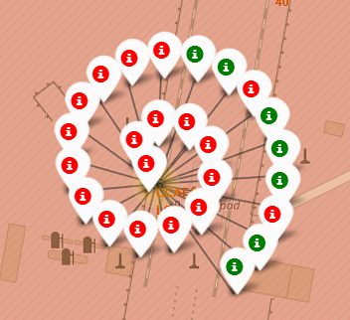
Colour-coded markers representing launch records on the map
Explanation:
The color-coded markers allow for easy identification of launch sites with relatively low success rates:
Green Marker: Indicates a successful launch
Red Marker: Indicates a failed launch
The CCAFS SLC-40 launch site demonstrates a low success rate.

Slide 37
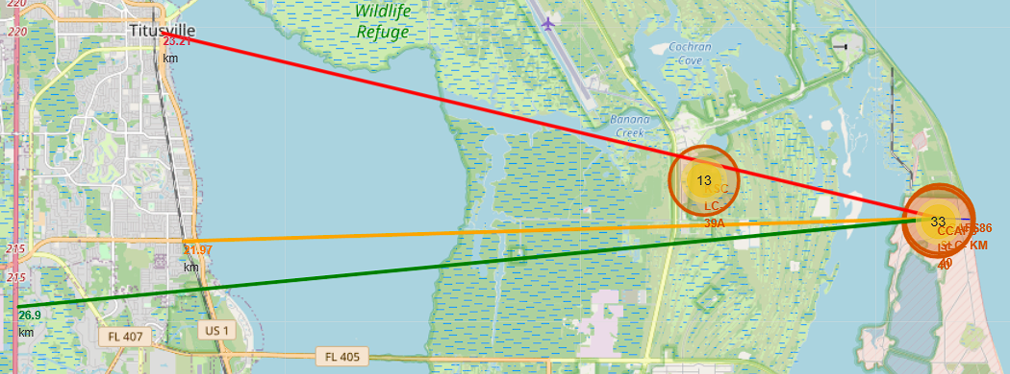
Distance between launch site CCAFS SLC-40 and its proximities
Explanation:
From the visual analysis of the launch site CCAFS SLC-40, we can observe that it is:
Relatively close to a railway (21.97 km away)
Relatively close to a highway (26.9 km away)
Very close to the coastline (0.86 km away)
Additionally, the launch site CCAFS SLC-40 maintains a safe distance from its closest city, Titusville, at 23.21 km
Considering the high speeds of failed rockets, which can cover distances of 20-25 km in a matter of seconds, it is clear that the proximity to populated areas and infrastructure like highways and railways poses some risk. However, the location close to the coastline minimizes the danger of debris falling into urban or heavily populated areas, enhancing safety for nearby residents and infrastructure

Slide 38

Section 4

Slide 39
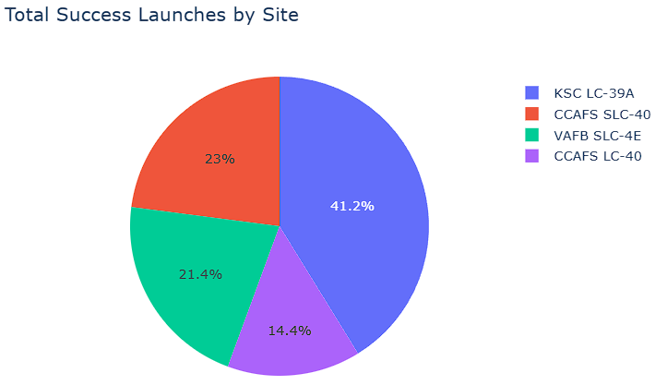
Total count of successful launches across all sites
Explanation:
The chart clearly indicates that KSC LC-39A has the highest number of successful launches among all the sites.

Slide 40
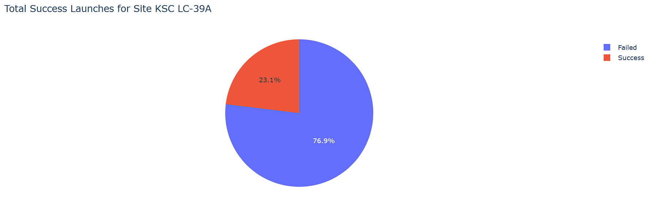
The launch site with the highest success rate
Explanation:
KSC LC-39A has the highest launch success rate (76.9%) with 10 successful and only had 3 failed landings

Slide 41
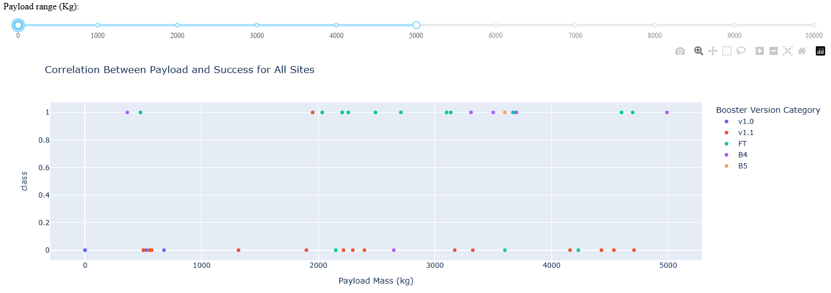
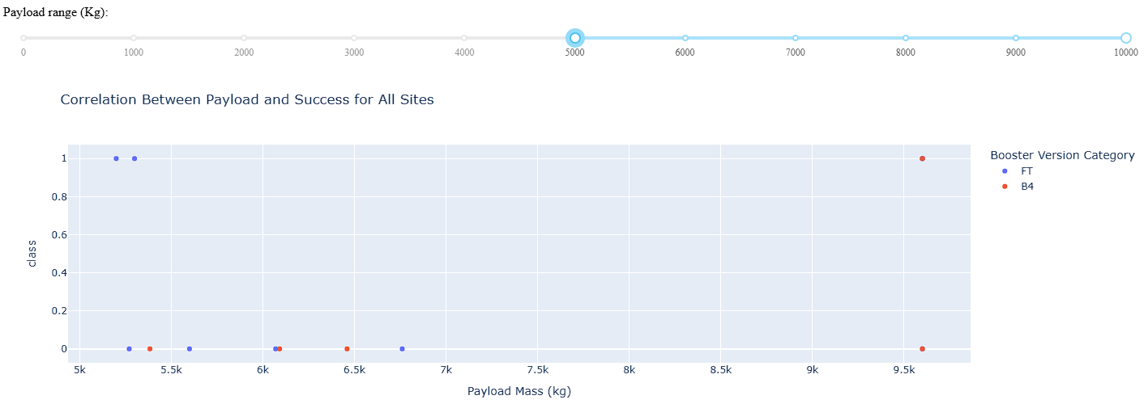
Relationship between Payload Mass and Launch Outcome across all sites
Explanation:
The charts indicate that payloads ranging from 2000 to 5500 kg achieve the highest success rate

Slide 42

Section 5

Slide 43
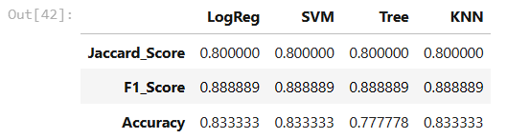
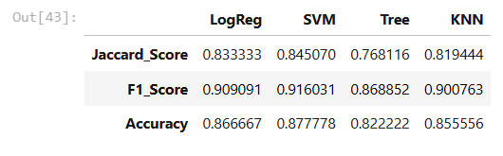
Classification Accuracy
Explanation:
The Test Set scores do not provide a definitive conclusion on which method performs best.
The identical Test Set scores may result from the small sample size (18 samples). To address this, all methods were evaluated using the entire dataset.
The results from the full dataset confirm that the Decision Tree Model is the best-performing model, achieving both higher scores and the highest accuracy.
Scores and Accuracy of the Test Set
Scores and Accuracy of the Entire Data Set

Slide 44
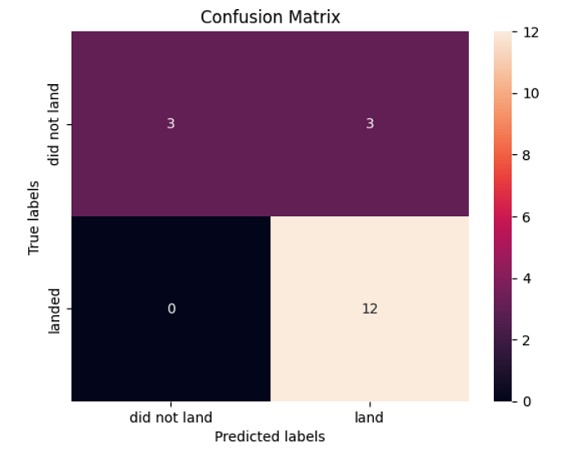
Confusion Matrix
Explanation:
Analyzing the confusion matrix reveals that logistic regression effectively distinguishes between the different classes. However, the primary issue lies in the occurrence of false positives

Slide 45
Conclusions
The Decision Tree Model has proven to be the most effective algorithm for this dataset.
Launches with lower payload masses tend to achieve better success rates compared to those with higher payloads.
Most launch sites are strategically located near the equator, taking advantage of the Earth's rotational speed, and all sites are positioned close to the coast for safety reasons.
The success rate of launches has shown a steady increase over the years.
Among all the sites, KSC LC-39A has the highest success rate for launches.
Orbits such as ES-L1, GEO, HEO, and SSO demonstrate a 100% success rate.

Slide 46
Appendix
https://www.ibm.com/
https://www.coursera.org/professional-certificates/ibm-data-science#instructors
https://www.coursera.org/

Slide 47


